Slide 1



CLICKBAIT CLASSIFICATION USING NATURAL LANGUAGE PROCESSING(NLP)
K.LAKSHMI - S190672
P.MAHIMA RATHNAM - S190885
P.KEERTHI - S190755
A.MANASA - S190971

Slide 2

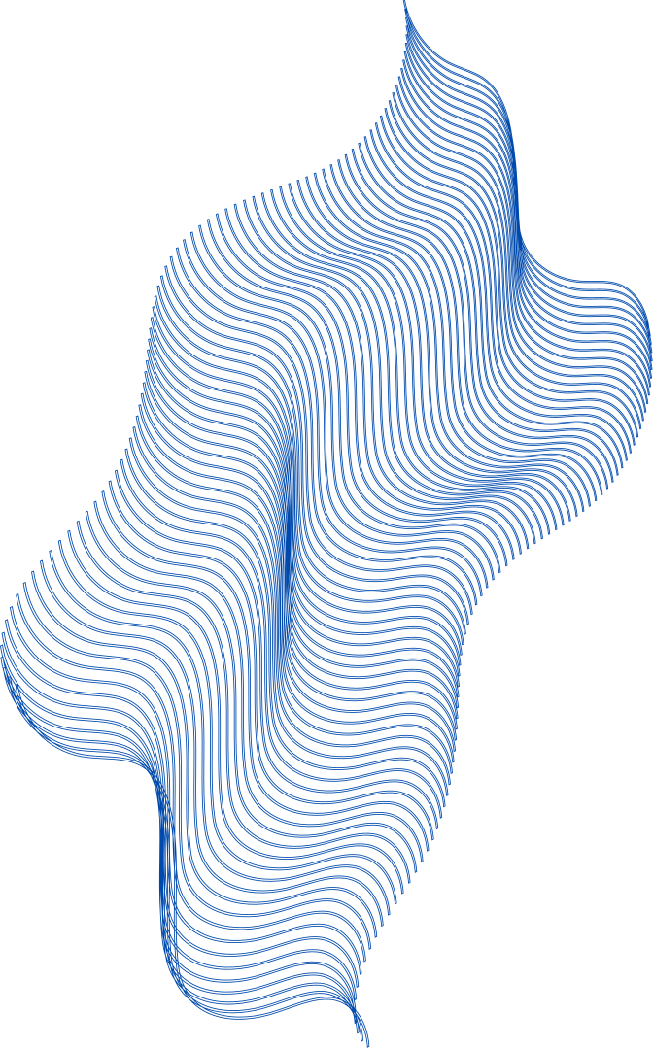
Introduction
Abstract
Existing system and disadvantages
Proposed system and advantages
Project details
Conclusion

Slide 3
INTRODUCTION:
Clickbait is a form of deceptive content designed to attract attention and entice users to click on a link to a particular web page.
Often, clickbait headlines exploit curiosity gaps or use exaggerated claims to drive traffic, which can result in disappointing user experiences.
Effective classification of clickbait content is essential for maintaining content quality and user trust. Machine learning (ML) provides powerful tools for automating the detection of clickbait content.

Slide 4
ABSTRACT:
Clickbait headlines are designed to attract attention and entice users to click on a link, often at the expense of providing misleading or exaggerated information.This study explores the application of ML techniques for the automated classification of clickbait headlines. We collect and preprocess a dataset of labeled headlines, converting textual data into numerical features using methods such as Term Frequency-Inverse Document Frequency (TF-IDF) and word embeddings.

Slide 5
Various ML models, including Logistic Regression, Naive Bayes, Support Vector Machines (SVM), and deep learning architectures are evaluated for their effectiveness in distinguishing clickbait from non-clickbait content. Performance is assessed using metrics like accuracy, precision, recall, and F1-score. Our results demonstrate that advanced ML models can achieve high accuracy in clickbait detection. The study also discusses the challenges and future directions in enhancing model robustness and handling evolving clickbait strategies.

Slide 6
EXISTING SYSTEM AND DISADVANTAGES:
These systems use classic algorithms like Logistic RegressionDecision Trees, and Random Forests for classification tasks.While effective in structured environments, traditional models often struggle with generalizing to new data due to the limitations of manually crafted features. Early methods relied heavily on manually crafted features such as word frequency, headline length, presence of sensational words, and punctuation marks.
Time consuming
Less Accurate

Slide 7
PROPOSED SYSTEM AND ADVANTAGES:
The proposed clickbait classification system aims to overcome the limitations of existing approaches by integrating state-of-the-art techniques and ensuring scalability and robustness. Assemble a diverse dataset from various sources including social media, news websites, and blogs to ensure a wide coverage of headline styles and topics.Apply data augmentation techniques to enhance the diversity of the training set, improving the model’s ability to generalize.Standardize and clean the text, remove noise, and tokenize the headlines for further processing.It uses NLP techniques integrated with the models which further helps in high accuracy of the system.
Faster
Accurate

Slide 8
PROJECT DETAILS :
Dataset:https://www.kaggle.com/datasets/amananandrai/clickbait-dataset
Software Requirements:
Python for coding and NLP implementation.
NLP libraries (e.g., NLTK) for text analysis.
Web framework (e.g.,HTML,CSS,JavaScript, Flask) for creating a user interface.
Hardware Requirements:
Standard computing hardware for model deployment.
Sufficient storage for storing data .

Slide 9
CONCLUSION:
The development of a real-time classification system via APIs enables seamless integration with content management systems .
This offers a comprehensive solution to the challenges posed by deceptive content. By harnessing the power of advanced models and continuous learning,
it sets a new standard for ensuring the integrity and quality of online information.

